Slide 1

Funding Your Future
Financing Your Cyber AI Career Path
CYBER HIRED 2026
25-minute panel session

Slide 2

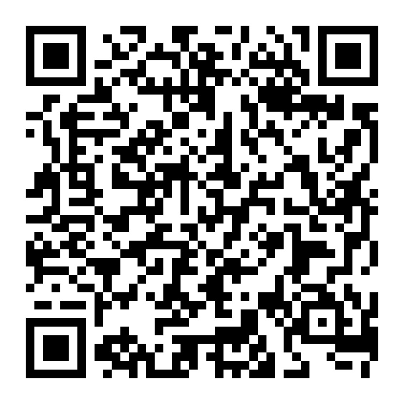
FREE ATTENDEE RESOURCE
Take the Financing Guide With You
Your free Cyber Funding Guide
Scan to download
and keep the guide.
Funding sources • Eligibility
Deadlines • Common mistakes
scippinternational.org/cyber-funding-guide/
SCIPP International
2

Slide 3
CYBER HIRED 2026
Four Questions to Answer Before You Pay
1
2
3
4
AVAILABLE?
→
ELIGIBLE?
→
COVERED?
→
SAFE?
What funding exists?
What fits me?
What will it pay?
What mistakes do I avoid?
Start with your career plan. Then match the money to the need.
SCIPP International
4

Slide 4

CYBER HIRED 2026
What Funding Is Available?
Military Credentialing Assistance and Tuition Assistance.
VA education benefits and VR&E.
WIOA and other workforce programs.
Employer reimbursement, scholarships and other assistance.
SCIPP International
5

Slide 5

CYBER HIRED 2026
What Funding Do I Qualify For?
Eligibility depends on your status and the program rules.
Some programs require approved credentials, providers or schools.
Some require authorization before enrollment or payment.
Confirm eligibility before spending personal funds.
SCIPP International
6

Slide 6

CYBER HIRED 2026
What Will My Funding Actually Pay For?
Certification preparation and training.
Certification exams and study materials.
Education or coursework where eligible.
Check whether Xternships, labs or career-development costs are covered.
Calculate any remaining out-of-pocket amount.
SCIPP International
7

Slide 7

CYBER HIRED 2026
Can I Combine Funding Sources?
Ask what eligible programs can be combined or sequenced.
Different sources may cover different allowable expenses.
Scholarships may help close remaining gaps.
Never assume two programs can pay the same expense—verify first.
SCIPP International
8

Slide 8
CYBER HIRED 2026
What Funding Mistakes Should I Avoid?
1
Assuming I don’t qualify
2
Waiting too long to apply
3
Missing approval deadlines
4
Using the wrong funding source
5
Failing to explore combinations
SCIPP International
9

Slide 9

CYBER HIRED 2026
What Certification Exam Benefit Should Veterans Ask About?
VA education benefits may reimburse certain approved licensing or certification test fees.
Eligibility, reimbursement and benefit-charge rules depend on the Veteran and exam.
Do not assume every Veteran or every exam is automatically covered.
Confirm the current benefit before scheduling or paying for the exam.
SCIPP International
10

Slide 10
CYBER HIRED 2026
Build Your Individual Funding Plan
1
2
3
4
TARGET
→
COST
→
MATCH
→
VERIFY
Choose the job
Price the gaps
Apply funding
Know your balance
Confirm eligibility, approvals and deadlines before enrollment.
SCIPP International
12

Slide 11
CYBER HIRED 2026
Take the Guide. Then Get Your Questions Answered.
1
Download and keep the Financing Guide.
2
Identify the funding source most likely to fit you.
3
Use CCA follow-up for your individual funding and career-path questions.
SCAN FOR YOUR GUIDE
SCIPP International
13

Slide 12

THANK YOU
Cyber Hired 2026 • Funding Your Future
Take the Financing Guide and plan your next step.
scippinternational.org/cyber-funding-guide/

Slide 13
POLL
Which funding source do you most want help understanding?
Military CA / Tuition Assistance
GI Bill / VA education benefits
VR&E
WIOA / workforce funding
Employer funding
Scholarships
Choose the answer that best describes you.

Slide 14
POLL
What is your biggest funding concern?
I don’t know what I qualify for
I don’t know what my benefit will pay for
I’m worried about deadlines / approval
I may still have an out-of-pocket gap
Choose the answer that best describes you.

