Slide 1
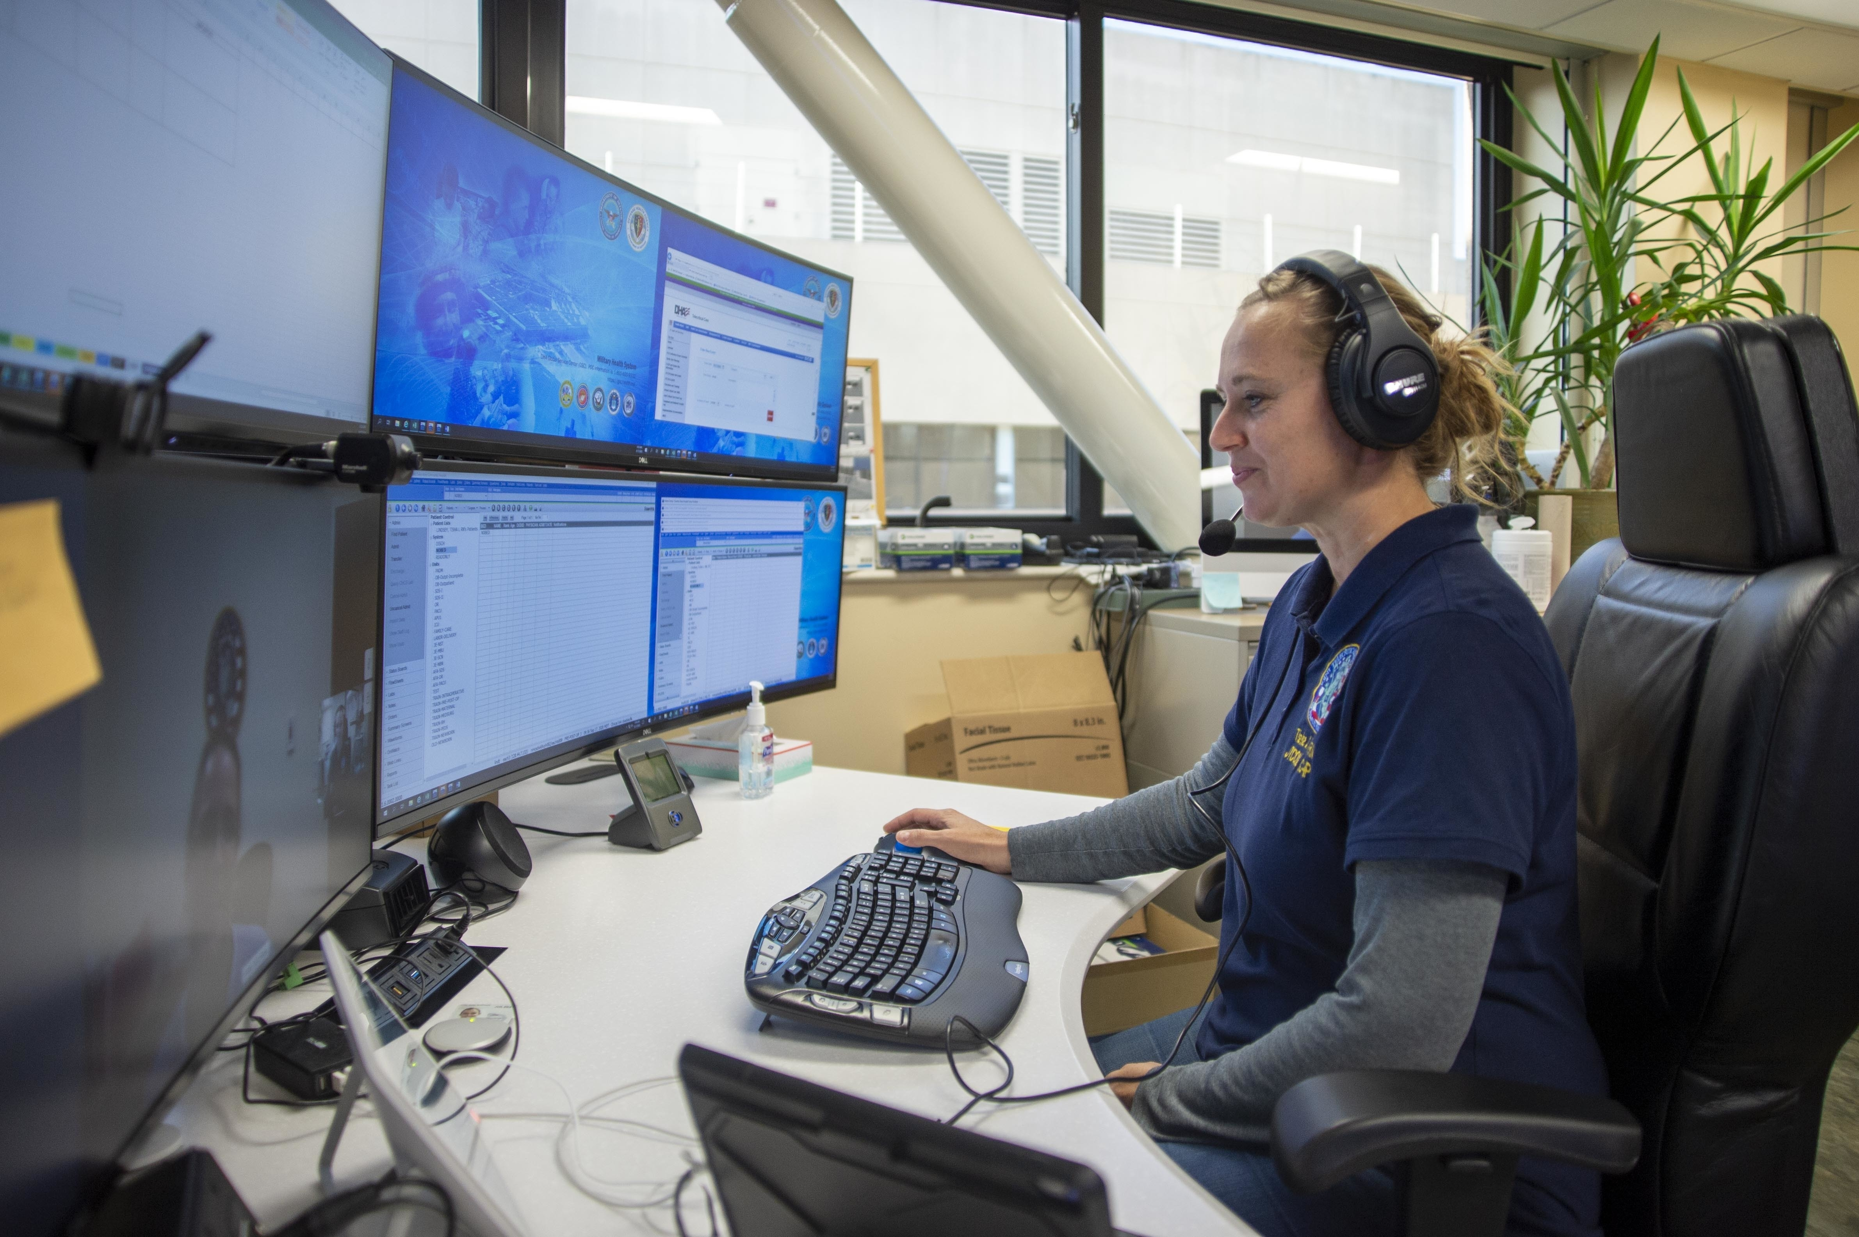
Building Your Path to a Cyber AI Career
From the right target → to experience → to people who can open doors
CYBER HIRED 2026
25-minute panel session

Slide 2

POLL
Where are you in your Cyber AI career transition?
Still exploring Cyber AI roles
Building certifications or skills
Need hands-on cyber experience
Applying for cyber jobs now
Already in cyber and looking to advance
Choose the answer that best describes you.

Slide 3
CYBER HIRED 2026
Your Cyber AI Career Path
1
2
3
4
TARGET
→
MATCH
→
PROVE
→
CONNECT
Choose the job
Know the qualifications
Find + add experience
Network + referrals
Start with the job you want. Build only the proof you need.
SCIPP International
3

Slide 4

CYBER HIRED 2026
Which Cyber AI Job Should I Target?
Choose a primary target and 1–2 related alternatives.
Match the target to your strengths and existing experience.
Use real job postings to see what employers actually seek.
SCIPP International
4

Slide 5
CYBER HIRED 2026
What Qualifications Does My Target Job Require?
Cyber project experience and hands-on skills.
Relevant cyber certifications.
Education when the role requires it.
Military, technical, business, risk or leadership experience.
SCIPP International
5

Slide 6
FIND IT
How Do I Find My Hidden Cyber Experience?
FIND IT
ADD IT
+
Use AI tools to uncover security, risk, compliance, troubleshooting, communications, data and leadership experience already in your background.
Reveal transferable cyber experience
Build the missing proof
SCIPP International
6

Slide 7

CYBER HIRED 2026
How Do I Build My Cyber Career Plan?
Compare what the target job requires with what you already have.
Prioritize the gaps that most improve job readiness.
Sequence: certification + project experience + networking + job search.
Use a CCA, coach or mentor for individualized planning.
SCIPP International
7

Slide 8

How Do I Get Hands-On Cyber Experience?
• Cyber Xternships™ and internships
• Hands-on labs and practical projects
• Military, workplace and volunteer projects
• Document your role, actions and results

Slide 9

CYBER HIRED 2026
How Do I Build My Professional Network?
Participate regularly in ISC2, ISACA and other cyber communities.
Have real conversations—not just LinkedIn connections.
Connect with instructors, mentors, peers and Xternship leaders.
Contribute useful comments and content so people learn what you know.
SCIPP International
9

Slide 10

CYBER HIRED 2026
How Do I Get Recommendations and Referrals?
Let mentors, faculty and project supervisors see the quality of your work.
Build the relationship before asking for a referral.
Ask people who know your capabilities to recommend appropriate opportunities.
Give recommenders the specific job and your targeted résumé.
SCIPP International
10

Slide 11
POLL
What is holding you back most right now?
Choosing the right Cyber AI job
Not enough cyber experience
Need another certification
Résumé / interviews are not producing offers
Need a stronger professional network
Choose the answer that best describes you.

Slide 12
CYBER HIRED 2026
What Should I Do Next?
1
2
3
4
TARGET
→
GAP
→
ACTION
→
CONNECT
Validate the job
Identify one gap
Add proof
Make one contact
Use CCA follow-up for detailed certification, résumé and individualized career planning.
SCIPP International
12

Slide 13

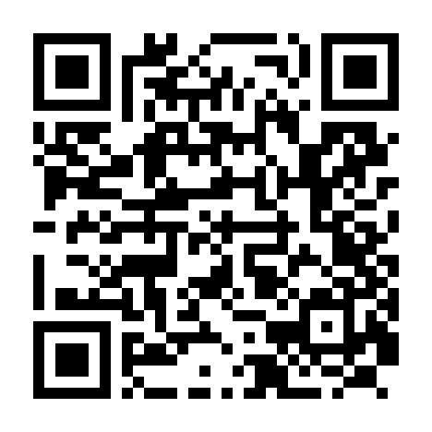
THANK YOU
Your cyber AI career starts today.
SCAN TO SCHEDULE
YOUR CCA MEETING
To
Stretch your COOL/VA Funds
With A
SCIPP Cyber Scholarship

